Slide 1

Team 4:H1-B Qualification Analysis 2015-2018
Team Members: Rui Zhong, Aditi Tyagi, Bosi Cheng, Junchao Lin

Slide 2
Why is this important?
Notes:
Aditi

Slide 3
Land of Immigrants
Notes:
visability

Slide 4
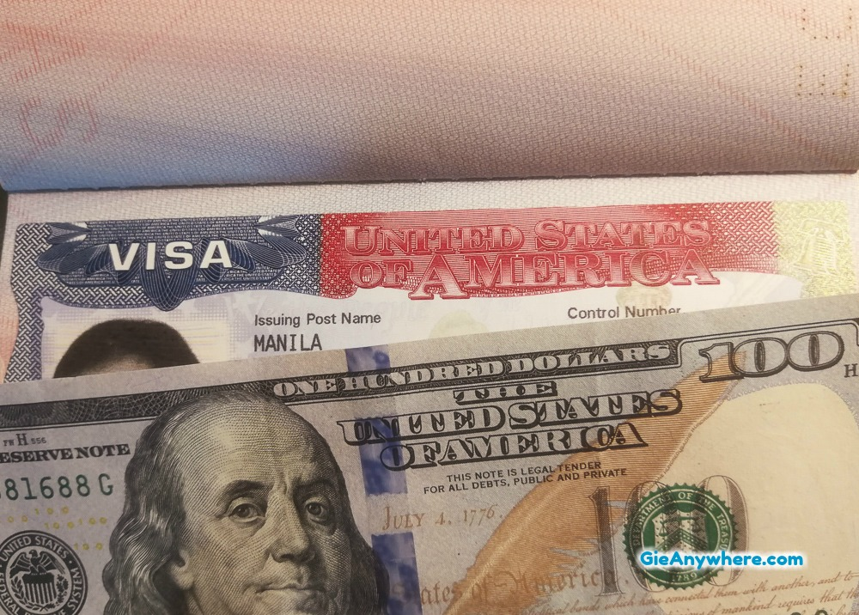

Find Sponsor Company
File LCA Form
Apply for H1B Petition
.

Slide 5
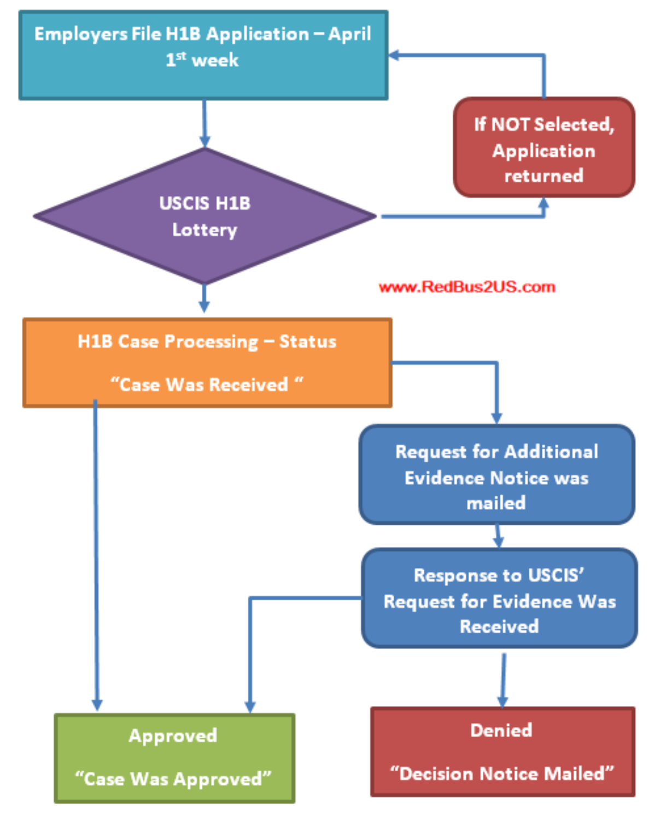

Slide 6
H1B applications
65,000
20,000
General Quota Applications
Masters Quota Applications

Slide 7
Data Set
Notes:
Aditi

Slide 8

Extracted excel file for fiscal years: 2015-2018
Combined into one csv
https://www.foreignlaborcert.doleta.gov/
Notes:
Aditi

Slide 9
US State Analysis
Notes:
Aditi

Slide 10
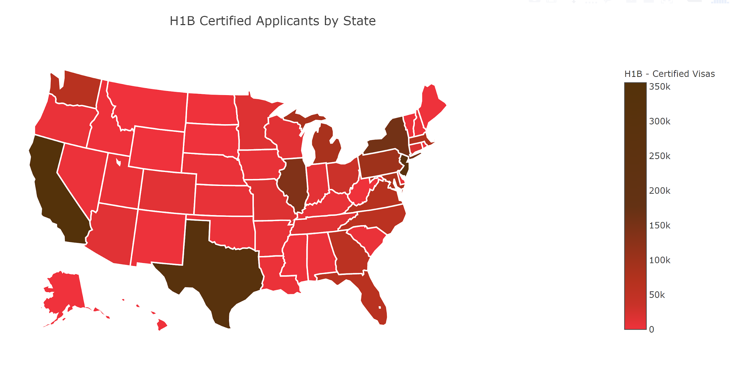
Number of H1B Certified Applicants in US States
Notes:
Aditi
file:///C:/Aditi/UCSD/Quarter2/ECE143-Python/Project/Team4-Project/applicants_certified.html

Slide 11
Job Title Analysis
Notes:
Rui

Slide 12
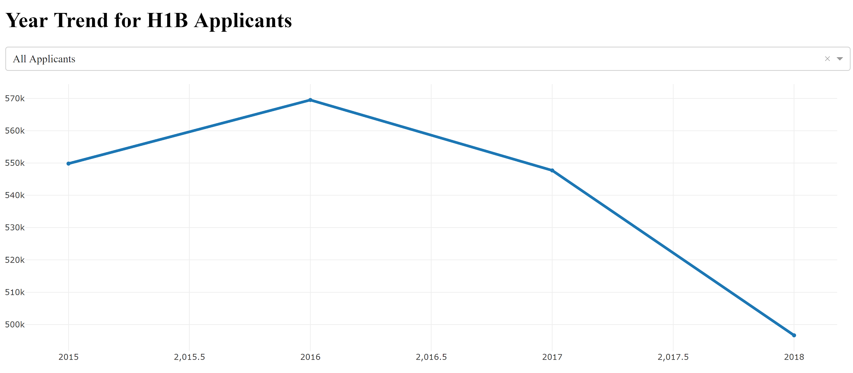
Trend Analysis over time for Certified Applicants
Notes:
-Aditi
http://127.0.0.1:8050/
Not year like 0.5
Used Dash - python framework for building analytical web applications - Used plotly package Dash is a Python framework for building analytical web applications.
Dash is a Python framework for building analytical web application

Slide 13
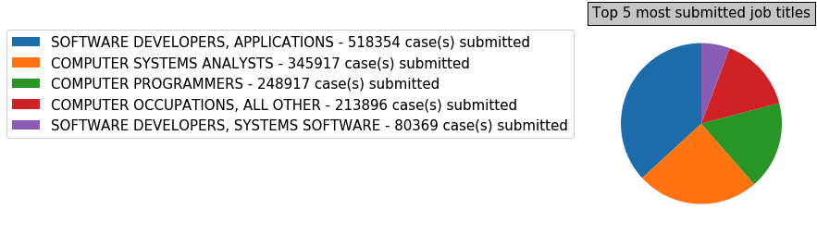
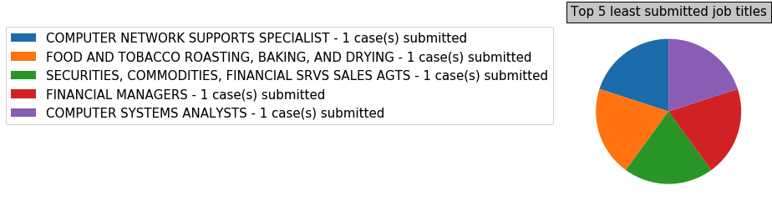
Job Title Applicants
Notes:
Totoal number of applicants - each job title
Rui
Spend more time on this

Slide 14
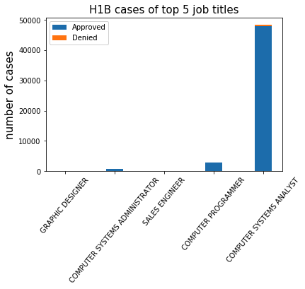
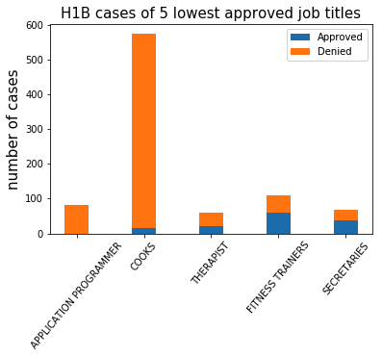
Approval Rate - Top 5 and Worst 5
Notes:
Rui

Slide 15
Company Analysis

Slide 16
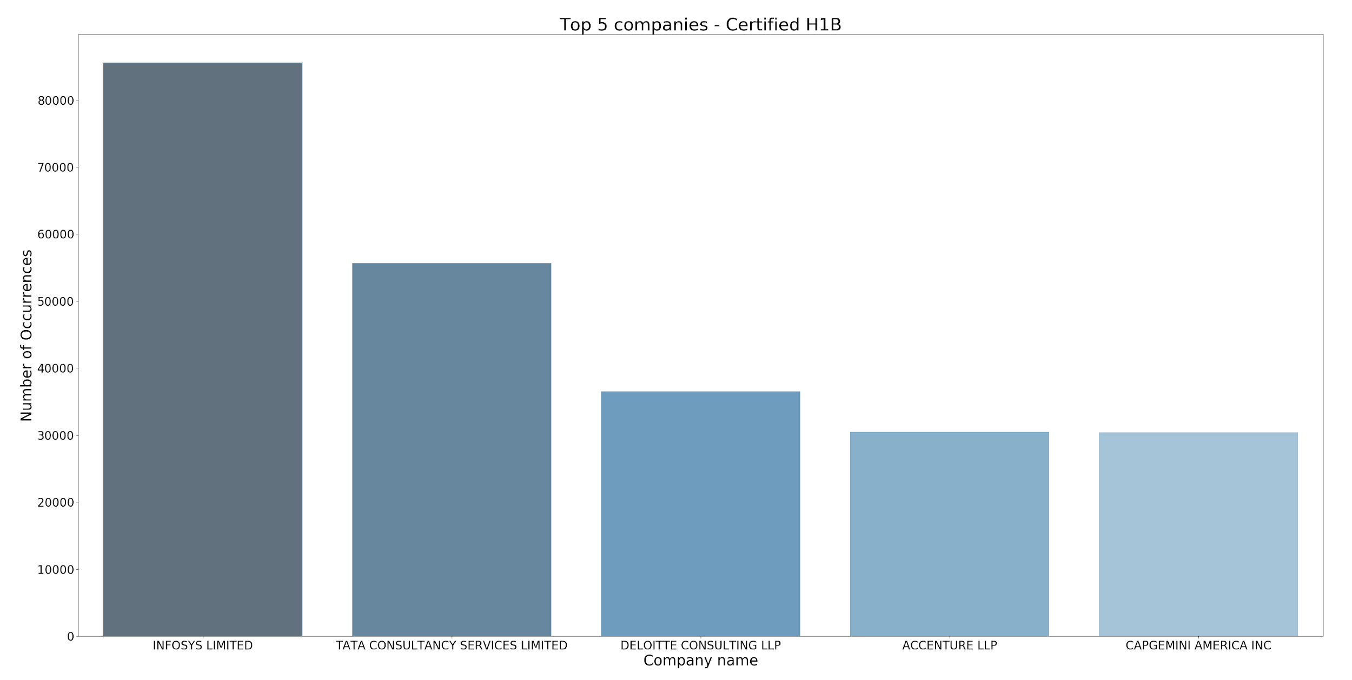
Top 5 Companies with Highest Certified Applicants
Notes:
Aditi
Seaborn : Seaborn is a Python data visualization library based on matplotlib. It provides a high-level interface for drawing attractive and informative statistical graphics.

Slide 17
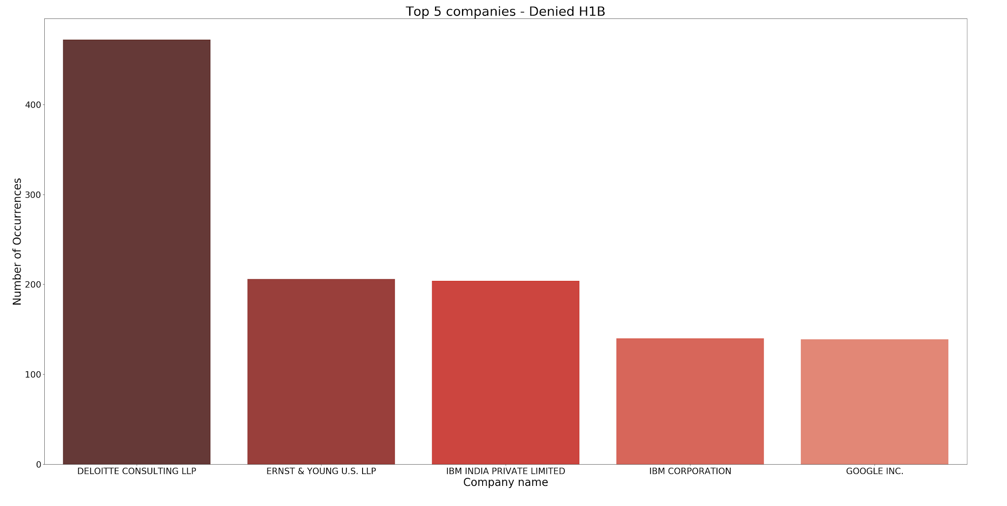
Top 5 Companies with Highest Denied Applicants
Notes:
Aditi
One color

Slide 18
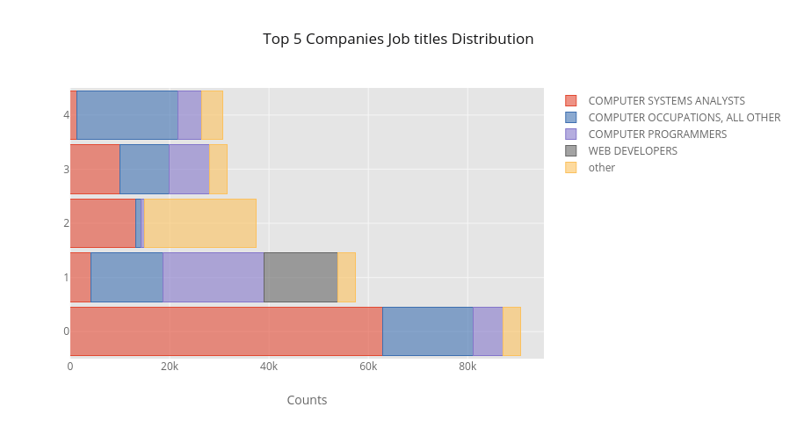
WIPRO
LIMITED
ACCENTURE
LLP
DELOITTE
CONSULTING
LLP
TATA
CONSULTANCY
SERVICES LIMITED
INFOSYS LIMITED
Top 5 Companies with Title distributions
Notes:
JL
Check the title for the top company and see if they do what the job title says. If it is computer related, then mention that computer related positions are popluar everyhwere
https://plot.ly/~Lanceljc/43/font-color-151516/#/

Slide 19
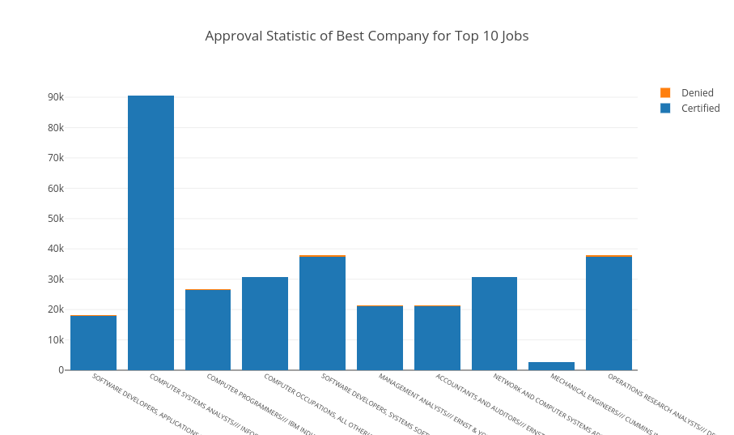
Approval rate- Top Company for each job title
Notes:
JL
https://plot.ly/~Lanceljc/37/stacked-bar-with-pandas/#/

Slide 20

Salary Analysis

Slide 21
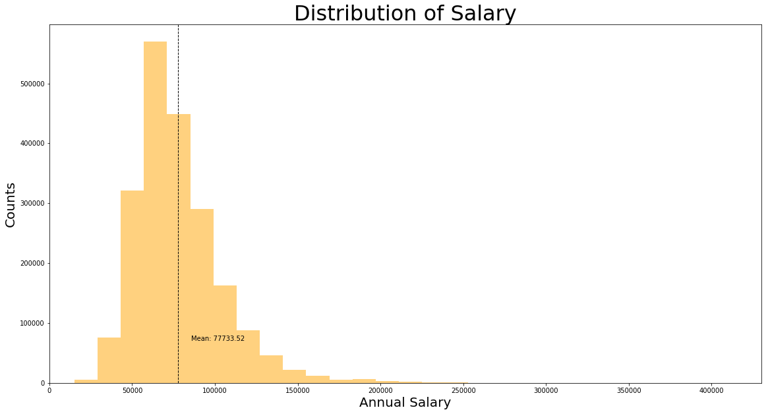
Salary Distribution for Certified Applicants
Notes:
JL

Slide 22
Recommender System

Slide 23
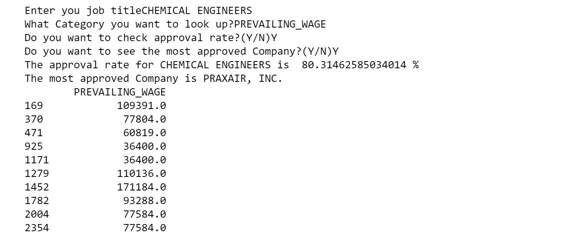

Slide 24
Conclusion

Slide 25

STATE
JOB TITLE
EMPLOYER TITLE
Notes:
Company and location - Title you’ll land up with when applying for H1B certification

Slide 26
THANK YOU

